Slide 1
Chapter 34
The Laws of Electromagnetism
Maxwell’s Equations
Displacement Current
Electromagnetic Radiation
Notes:
2

Slide 2
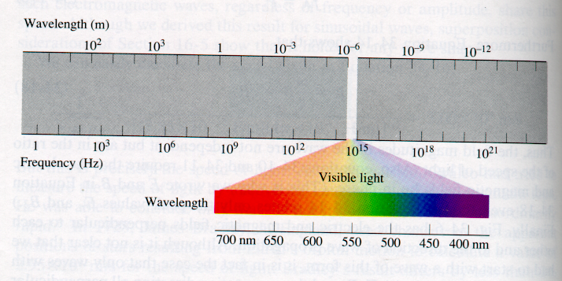
The Electromagnetic Spectrum
Radio waves
infra
-red
ultra
-violet
γ-rays
μ-wave
x-rays

Slide 3
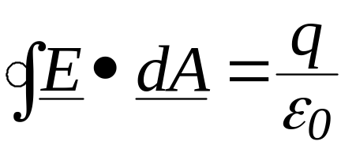
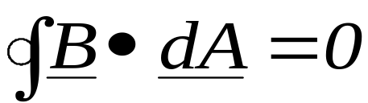
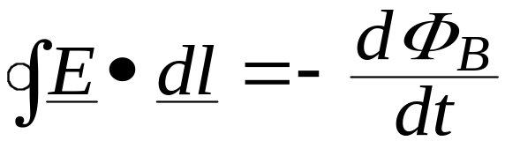
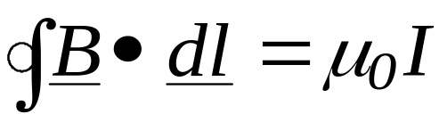
The Equations of Electromagnetism
(at this point …)
Gauss’ Law for Electrostatics
Gauss’ Law for Magnetism
Faraday’s Law of Induction
Ampere’s Law
Notes:
3

Slide 4

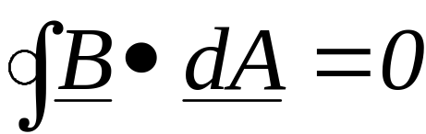
The Equations of Electromagnetism
Gauss’s Laws
..monopole..
1
?
2
...there’s no
magnetic monopole....!!
Notes:
10

Slide 5
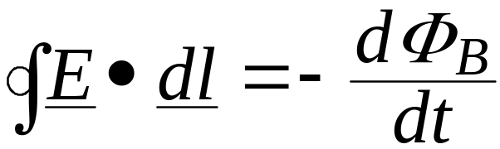
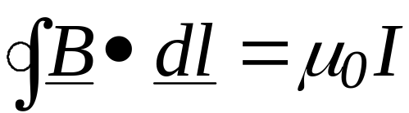
The Equations of Electromagnetism
.. if you change a
magnetic field you
induce an electric
field.........
Faraday’s Law
3
Ampere’s Law
4
.......is the reverse
true..?
Notes:
12

Slide 6
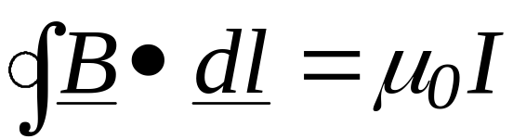
...lets take a look at charge flowing into a capacitor...
...when we derived Ampere’s Law
we assumed constant current...
E
B

Slide 7
...lets take a look at charge flowing into a capacitor...
...when we derived Ampere’s Law
we assumed constant current...
E
B
E
.. if the loop encloses one
plate of the capacitor..there is a problem … I = 0
B
Side view: (Surface
is now like a bag:)
Notes:
14

Slide 8
Maxwell solved this problem
by realizing that....
B
E
Inside the capacitor there must
be an induced magnetic field...
How?.

Slide 9
Maxwell solved this problem
by realizing that....
B
E
Inside the capacitor there must
be an induced magnetic field...
How?. Inside the capacitor there is a changing E ⇒
B
A changing electric field
induces a magnetic field
x
x x x x
E
x x x x x
x x

Slide 10
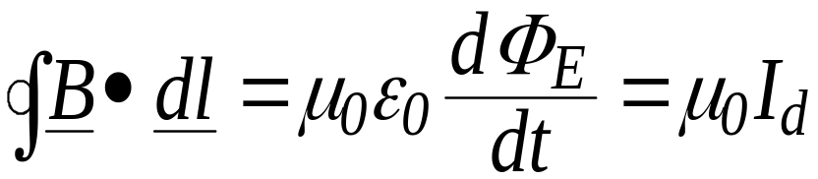
Maxwell solved this problem
by realizing that....
B
E
Inside the capacitor there must
be an induced magnetic field...
How?. Inside the capacitor there is a changing E ⇒
B
A changing electric field
induces a magnetic field
x
x x x x
E
x x x x x
where I_{d} is called the
displacement current
x x

Slide 11
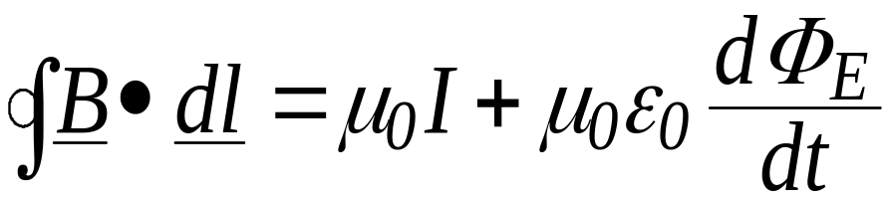
Maxwell solved this problem by realizing that....
B
E
Inside the capacitor there must
be an induced magnetic field...
How?. Inside the capacitor there is a changing E ⇒
B
A changing electric field
induces a magnetic field
x
x x x x
E
x x x x x
where I_{d} is called the
displacement current
x x
Therefore, Maxwell’s revision
of Ampere’s Law becomes....
Notes:
18

Slide 12
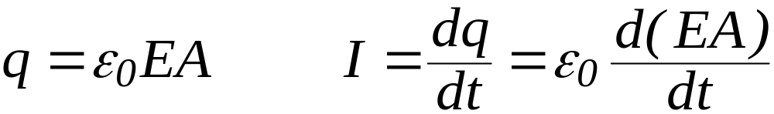
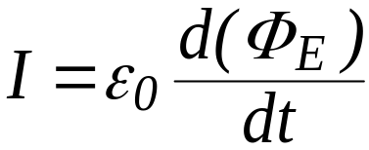
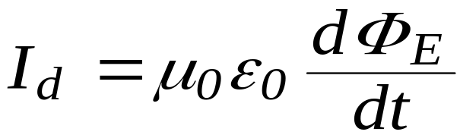
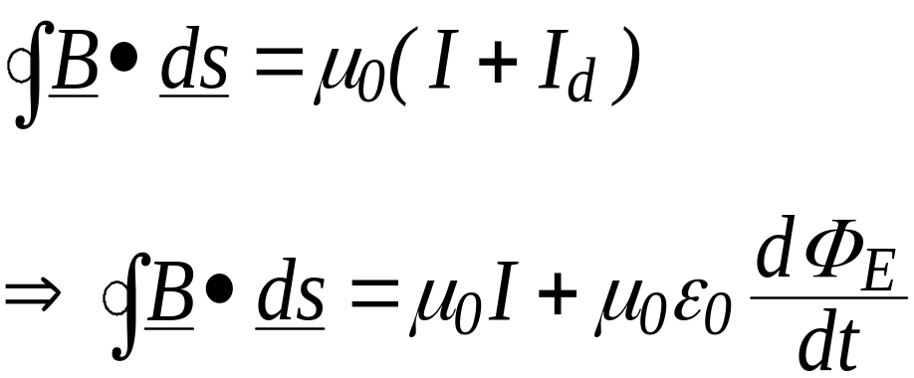
Derivation of Displacement Current
For a capacitor, and .
Now, the electric flux is given by EA, so: ,
where this current , not being associated with charges, is
called the “Displacement current”, I_{d}.
Hence:
and:
Notes:
19

Slide 13

Derivation of Displacement Current
For a capacitor, and .
Now, the electric flux is given by EA, so: ,
where this current, not being associated with charges, is
called the “Displacement Current”, I_{d}.
Hence:
and:
Notes:
20

Slide 14
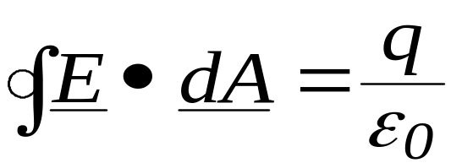

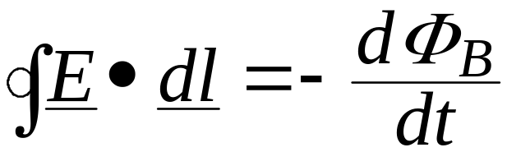

Maxwell’s Equations of Electromagnetism
Gauss’ Law for Electrostatics
Gauss’ Law for Magnetism
Faraday’s Law of Induction
Ampere’s Law
Notes:
21

Slide 15
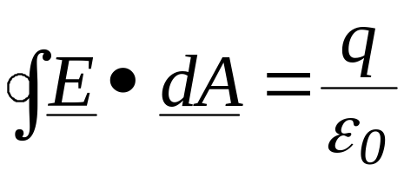
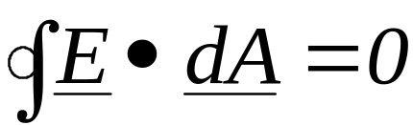
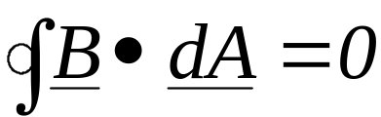

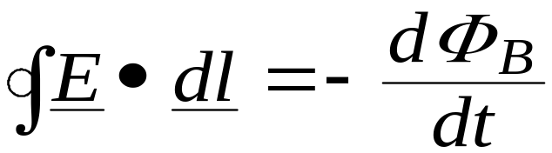

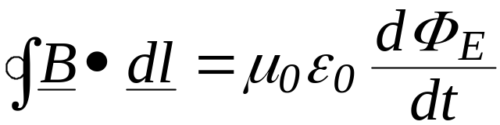
Maxwell’s Equations of Electromagnetism in Vacuum (no charges, no masses)
Consider these equations in a vacuum.....
......no mass, no charges. no currents.....
Notes:
22

Slide 16
Maxwell’s Equations of Electromagnetism
in Vacuum (no charges, no masses)

Slide 17
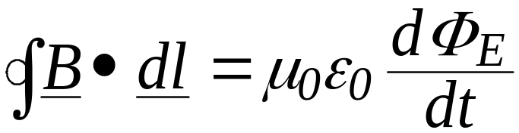

Electromagnetic Waves
Faraday’s law: dB/dt electric field
Maxwell’s modification of Ampere’s law
dE/dt magnetic field
These two equations can be solved simultaneously.
ˆ
E(x, t) = E_{P} sin (kx-ωt)
B(x, t) = B_{P} sin (kx-ωt)
j
The result is:
ˆ
z
Notes:
24
1

Slide 18




Electromagnetic Waves
B
E
Notes:
25
2

Slide 19

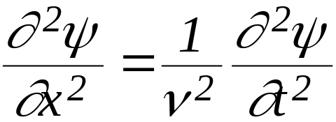
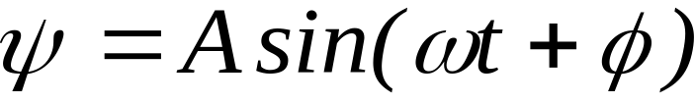
Electromagnetic Waves
B
E
Special case..PLANE WAVES...
satisfy the wave equation
Maxwell’s Solution
Notes:
26
2

Slide 20
Plane Electromagnetic Waves
E_{y}
B_{z}
c
x
ˆ
E(x, t) = E_{P} sin (kx-ωt)
B(x, t) = B_{P} sin (kx-ωt)
j
ˆ
z
Notes:
27
3

Slide 21
F(x)
λ
Static wave
F(x) = F_{P} sin (kx + φ)
k = 2π / λ
k = wavenumber
λ = wavelength
x
F(x)
λ
Moving wave
F(x, t) = F_{P} sin (kx - ωt )
ω = 2π / f
ω = angular frequency
f = frequency
v = ω / k
v
x

Slide 22
F
v
Moving wave
F(x, t) = F_{P} sin (kx - ωt )
x
What happens at x = 0 as a function of time?
F(0, t) = F_{P} sin (-ωt)
For x = 0 and t = 0 ⇒ F(0, 0) = F_{P} sin (0)
For x = 0 and t = t ⇒ F (0, t) = F_{P} sin (0 – ωt) = F_{P} sin (– ωt)
This is equivalent to: kx = - ωt ⇒ x = - (ω/k) t
F(x=0) at time t is the same as F[x=-(ω/k)t] at time 0
The wave moves to the right with speed ω/k

Slide 23
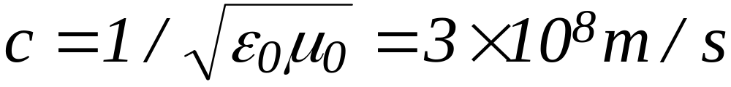
Plane Electromagnetic Waves
E_{y}
ˆ
E(x, t) = E_{P} sin (kx-ωt)
B(x, t) = B_{P} sin (kx-ωt)
j
ˆ
z
B_{z}
Notes: Waves are in Phase,
but fields oriented at 90⁰.
k=2π/λ.
Speed of wave is c=ω/k (= fλ)
At all times E=cB.
c
x
Notes:
29
3

